Slide 1
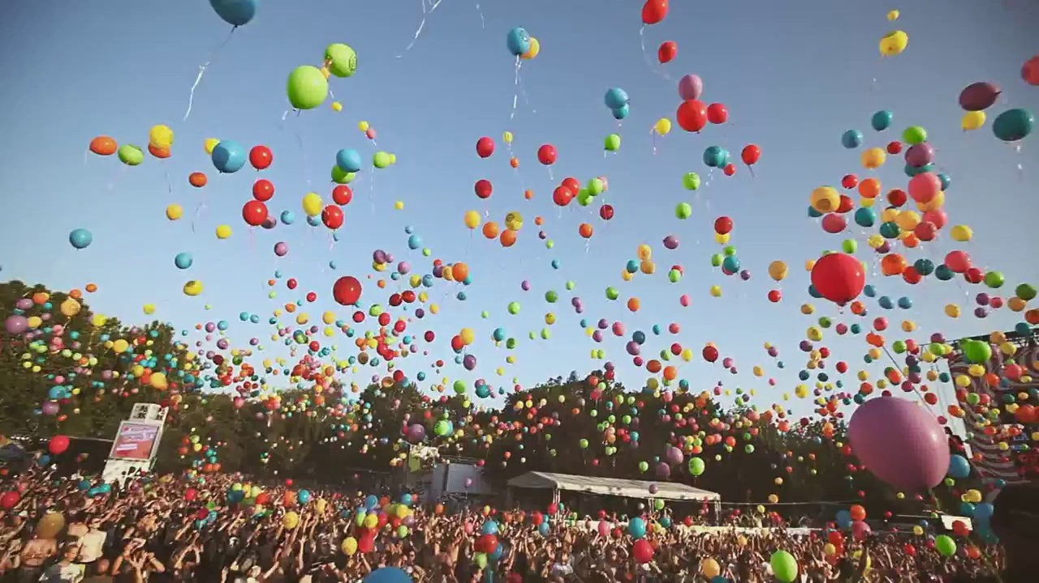
3.2. Food at festivals
Coursebook: Objective Ket (page 22)
Teacher: Trinh Thi Mong Ngoc

Slide 2
Learning outcomes
Learn some new words about festivals and do Right/Wrong exercise.
Use adverbs of frequency in appropriate situations.

Slide 3
I. READING
Before you read, answer the following questions
What are some important festivals in your country?
What is your favourite festival? Why? When is it celebrated? What do people usually do in the festival?

Slide 4
VOCABULARY
Festival (n) /ˈfes.tɪ.vəl/: a special day or period, usually in memory of a religious event, with social activities, food, or ceremonies.
Square (n) /skweər/: an area of approximately square-shaped land in a city or a town, often including the buildings that surround it.
Firework (n) /ˈfaɪə.wɜːk/: device containing chemicals that burn or explode with colored flames.
To throw (v) /θrəʊ/ : to send something through the air with some force, especially by moving the arm.

Slide 5
Read the text below about a festival in Spain.
Antonio lives in the city of Valencia in Spain. Every year he goes to La Tomatina Festival in Bunol, a town near Valencia. The festival is on the last Wednesday in August, when everyone comes into the main square to throw tomatoes at each other.
Before the fun begins, people cover the shop windows with plastic. Antonio always wears his oldest clothes so he doesn't get his best clothes dirty. He also always puts his camera in a plastic bag to keep it clean. In the morning trucks arrive in the main square, the Plaza del Pueblo, bringing more than 100,000 kilos of tomatoes. The fight begins at 11 o'clock and always lasts for two hours. At exactly 1 o'clock everyone stops. They never throw tomatoes after 1 o'clock. They then usually spend the rest of the day cleaning themselves and the town! In the evening, Antonio usually watches the fireworks, eats the local food and sometimes joins in the dancing.

Slide 6
Decide if the following statements are Right or Wrong.
1. Antonio comes from Buno!
Wrong (Antonio lives in the city of Valencia in Spain).
2. The festival is at the beginning of August.
=> Wrong (The festival is on the last Wednesday in
August).
3. Antonio never wears his best clothes to the festival.
Right (Antonio always wears his oldest …)
4. Everyone buys tomatoes from a local shop.
=> Wrong (In the morning trucks arrive in the
main square, the Plaza del Pueblo, bringing more than
100,000 kilos of tomatoes. )

Slide 7
5. The fight usually lasts for more than two hours.
=> Wrong (The fight …..always lasts for two hours).
6. The next day everyone cleans the streets.
Wrong (They then usually spend the rest of the day cleaning themselves and the town).
7. Antonio always watches the fireworks.
Wrong (Antonio usually watches the fireworks).
8. Antonio sometimes dances.
=> Right (Antonio ….sometimes joins in the dancing).

Slide 8
After you read, match the name of the festival in column A with the day it is celebrated in column B
A | B
1. Christmas Day | a. 31 December
2. World Teacher’s Day | b. 31 October
3. Halloween | c. 14 February
4. New Year’s Eve 5. Valentine’s Day 6. April Fool’s Day | d. 25 December e. 1 April f. November
7. Thanksgiving | g. October

Slide 9
Answer keys
1-d
2-g
3-b
4-a
5-c
6-e
7-f

Slide 10
II. GRAMMAR – Adverbs of frequency
Always (100%)
Usually
Often
Sometimes
Never (0%)

Slide 11
USES and EXAMPLES:
Adverbs of frequency come ...
• before most verbs: He always goes to the festival .
• after the verb “be”: I am always late for dinner.
• Sometimes can also be placed at the beginning or end of the sentence:
I am sometimes late for school. Sometimes I am late for school. I am late for school sometimes.

Slide 12
PRACTICE EXERCISE:
Complete these sentences with always, often, usually, sometimes or never.
Example: I get up at 9 o'clock. (100%)
I always get up at 9 o’clock.
1. My mother makes cakes on Tuesdays. (75%)
=> ……………………………………………………………………………
2. I am hungry at lunch time. (100%)
=> ……………………………………………………………………………

Slide 13
3. I am late for dinner. (55%)
……………………………………………………………………………………..
4. Pete has a party on his birthday. (100%)
……………………………………………………………………………………..
5. We have fireworks on New Year's Eve. (25%)
……………………………………………………………………………………..
6. Sam meets his friends on New Year's Eve. (90%)
……………………………………………………………………………………..
7. You eat spaghetti with a knife. (0%)
=> ……………………………………………………………………………………..

Slide 14
Answer keys
My mother usually makes cakes on Tuesdays. (75%)
I am always hungry at lunch time. (100%)
I am often late for dinner. (55%)
4. Pete always has a party on his birthday. (100%)
5. We sometimes have fireworks on New Year's Eve. (25%)
6. Sam usually meets his friends on New Year's Eve. (90%)
7. You never eat spaghetti with a knife. (0%)

Slide 15
THE END

