Slide 1
ANH VĂN KHÔNG CHUYÊN 2
GIẢNG VIÊN: TRẦN THỊ PHƯƠNG THUỲ

Slide 2
UNIT 2
I AM A FRIENDLY PERSON

Slide 3
Learning outcomes: Students will be able to:
Identify the main topic of reading.
Scan and skim to do excersise
Teaching method: Lecturing, individual, pairworks and groupworks.
Materials: Objective PET ( Cambridge English)

Slide 5
Brian is well-built/ slim.
Brian’s got straight/ curly/ wavy hair.
Brian’s got long/ round/ square face.

Slide 6
Stella has got long/medium length/ short dark hair.
Stella has got pale/ dark complexion.
Stella is fat/ well-built/ slim.

Slide 7
Match the words or phrases on the left (1 – 10) with the correct definition
1. accommodation | to keep things clean and organized.
2. travel | b. to have equal responsibility for paying the petrol.
3. contact | c. a place where people can live, work or stay.
4.to be tidy | d. an exciting or dangerous experience.
5. a pen- friend | e. to get in touch or communicate with someone.
6.to share the cost of petrol | f. a particular way of living or the way a person lives or a group of people live.
7. adventure | g. person who you exchange letters with even though you have never met.
8. hostel | h. to have a free ride in a vehicle.
9.to need a lift | i. an inexpensive place for usually young travelers to stay overnight.
. lifestyle | j. to go on a trip or to get to a place.

Slide 8
1. accommodation
c. a place where people can live, work or stay.
2. to travel
j. to go on a trip or to get to a place.
3. to contact
e. to get in touch or communicate with someone.
4. to be tidy
a. to keep things clean and organized.
5. a pen- friend
g. a person who you exchange letters with even though you have never met.

Slide 9
6. to share the cost of petrol
b. to have equal responsibility for paying the gas.
7.adventure
d. an exciting or dangerous experience.
8. hostel
i. an inexpensive place for usually young travelers to stay overnight.
9. to need a lift
h. to have a free ride in a vehicle.
10. lifestyle
f. a particular way of living or the way a person lives or a group of people live.

Slide 10
reading

Slide 11
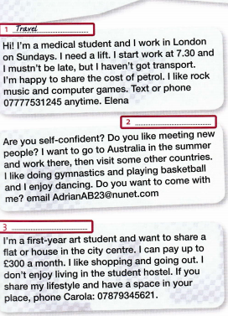

Slide 12
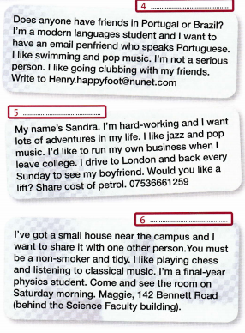

Slide 13
Read the following statements and decide if these sentences are true or false. Write the tick (V) for your answers.
Elena wants to share the cost of petrol to someone who needs a lift to London.
2.Adrian’s hobbies are dancing and playing sports.
3. Carola needs someone to share a house with her to pay less for her renting.
4. If you want to contact with Sandra, you can email her.
5.Sandra was running a company while she was at college.
6. Maggie needs a person who doesn’t smoke and keeps things clean.
7. You can call Maggie if you want to share a house with her.
8.Henry wants to have a pen friend who can speak Portuguese because he can’t speak it.

Slide 14
Elena wants to share the cost of petrol to someone who needs a lift to London. F
2. Adrian’s hobbies are dancing and playing sports. T
3. Carola needs someone to share a house with her because she wants to pay less for her renting. T
4. If you want to contact with Sandra, you can email her. F

Slide 15
5. Sandra was running a company while she was at college. F
Maggie needs a person who doesn’t smoke and keeps things clean. T
7. You can call Maggie if you want to share a house with her. T
8. Henry wants to have a pen friend who can speak Portuguese because he can’t speak it. F

