Slide 1
GiỚI THIỆU BÀI:
Bài học này liên quan đến chủ đề
NGHỀ NGHIỆP được miêu tả 1 cách ngắn gọn sử dụng thì hiện tại đơn.
KẾT QUẢ HỌC TẬP:
Qua bài học này người học có thể:
Miêu tả ngắn gọn về nghề nghiệp hoặc công việc.
Sử dụng thì hiện tại đơn khi miêu tả công việc/ nghề nghiệp.
Thảo luận/ nói thêm về nghề nghiệp/ công việc.

Slide 2
QUIZ: WHAT’S HER JOB? Who is she? What does she do?
TOPIC: JOBS/ OCCUPATION
Nguyễn Thị Ngọc Hường
Bộ môn Tiếng Anh / English Department
Khoa Ngoại Ngữ / School of Foreign Languages
Đại học Trà Vinh / TVU

Slide 3
1/- ANSWER QUESTIONS ABOUT JOBS/ OCCUPATIONS (whole class work)
Example:
QUESTION:
He plays the guitar in a music band.
Who is he? or: What does he do?
ANSWER: He is a guitarist.

Slide 4
She takes care of sick people or patients in a hospital.
Who is she?
What does she do?
(What’s her job?)
(What’s her occupation?)

Slide 5
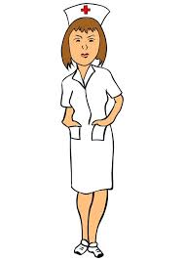
She takes care of sick people or patients in a hospital.
Who is she?
What does she do?

Slide 6
She takes care of sick people or patients in a hospital.
She is a nurse.

Slide 7
2. He designs websites.
Who is he?
What does he do?
(What’s his job?)
(What’s his occupation?)

Slide 8
2. He designs websites.
Who is he?
What does he do?

Slide 9
2. He designs websites.
He is a web designer.

Slide 10
3. He teaches students in a school.
Who is he?
What does he do?
(What’s his occupation?)

Slide 11
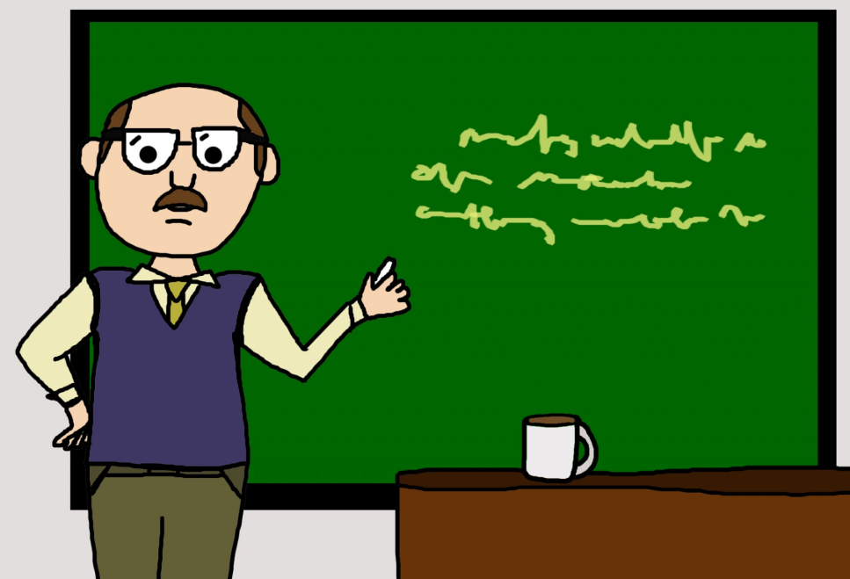
3. He teaches students in a school.
Who is he?
What does he do?
(What’s his occupation?)

Slide 12
3. He teaches students in a school.
He is a teacher.

Slide 13
4. He mends engines and changes tires.
Who is he? What does he do?
(What’s his occupation?)

Slide 14
4. He mends engines and changes tires.
Who is he?
What does he do?
(What’s his occupation?)

Slide 15
4. He mends engines and changes tires.
He is a mechanic.

Slide 16
5. She cuts and does
people’s hair.
Who is she?
What does she do?
(What’s her job?)

Slide 17
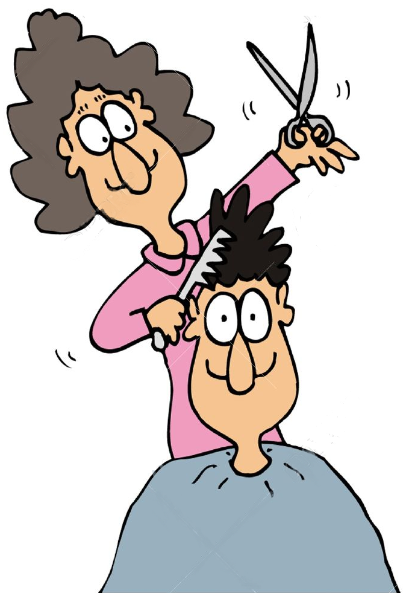
5. She cuts and does people’s hair.
Who is she?
What does she do?
(What’s her job?)

Slide 18
5. She cuts and does
people’s hair.
She is a hair-dresser.

Slide 19
6. She helps to sell clothes in a fashion shop.
Who is she?
What does she do?
(What’s her job?)

Slide 20
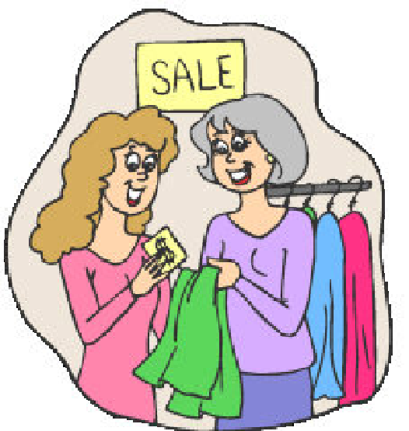
6. She helps to sell clothes in a fashion shop.
Who is she?
What does she do?
(What’s her job?)

Slide 21
6. She helps to sell clothes in a fashion shop.
She is a shop assistant.

Slide 22
7. He designs roads and bridges.
Who is he? What does he do?
(What’s his occupation?)

Slide 23
7. He designs roads and bridges.
Who is he?
What does he do?
(What’s his occupation?)

Slide 24
7. He designs roads and bridges.
He is an engineer.

Slide 25
8. She looks after passengers on a plane.
Who is she?
What does she do?
(What’s her job?)

Slide 26
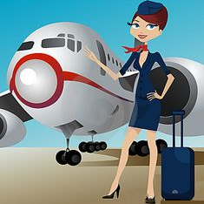
8. She looks after passengers on a plane.
Who is she?
What does she do?
(What’s her job?)

Slide 27
8. She looks after passengers on a plane.
She is a flight attendant.

Slide 28
9. She draws and paints pictures.
Who is she?
What does she do?
(What’s her job?)

Slide 29
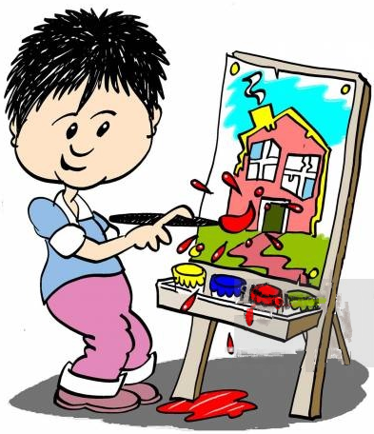
9. She draws and paints pictures.
Who is she?
What does she do?
(What’s her job?)

Slide 30
9. She draws and paints pictures.
She is a painter/ an artist.

Slide 31
10. She sings songs and sometimes dances on a stage.
Who is she?
What does she do?
(What’s her job?)

Slide 32
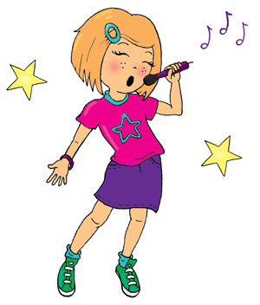
10. She sings songs and sometimes dances on a stage.
Who is she?
What does she do?
(What’s her job?)

Slide 33
10. She sings songs and sometimes dances on a stage.
She is a singer.

Slide 34
11. He flies a plane.
Who is he?
What does he do?
(What’s his occupation?)

Slide 35
11. He flies a plane.
Who is he? What does he do?
(What’s his occupation?)

Slide 36
11. He flies a plane.
He is a pilot.

Slide 37
12. He cooks food in a restaurant.
Who is he?
What does he do?
(What’s his job?)

Slide 38
12. He cooks food in a restaurant.
Who is he?
What does he do?
(What’s his job?)

Slide 39
12. He cooks food in a restaurant.
He is a cook/ a chef.

Slide 40
13. She makes dresses, shirts, and pants.
Who is she?
What does she do?
(What’s her job?)

Slide 41
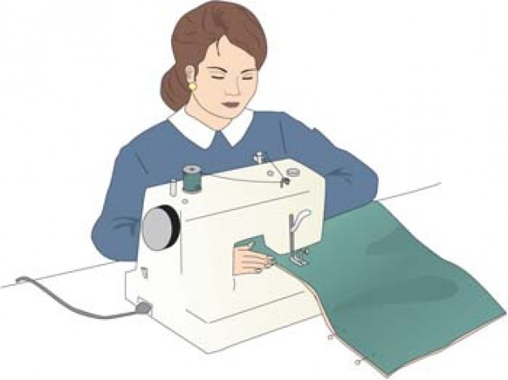
13. She makes dresses, shirts, and pants.
Who is she?
What does she do?
(What’s her job?)

Slide 42
13. She makes dresses, shirts, and pants.
She is a dress-maker/ a tailoress.

Slide 43
14. He grows vegetables, fruit on his farm.
Who is he?
What does he do?
(What’s his job?)

Slide 44
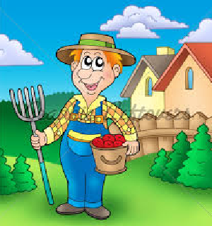
14. He grows vegetables, fruit on his farm.
Who is he?
What does he do?
(What’s his job?)

Slide 45
14. He grows vegetables, fruit on his farm.
He is a farmer.

Slide 46
15. She types reports, gets letters, and arranges meetings.
Who is she?
What does she do?
(What’s her job?)

Slide 47
15. She types reports, gets letters, and arranges meetings.
Who is she?
What does she do?
What’s her job?)

Slide 48
15. She types reports, gets letters, and arranges meetings.
She is a secretary.

Slide 49
16. She designs houses for people.
Who is she?
What does she do?
(What’s her occupation?)

Slide 50
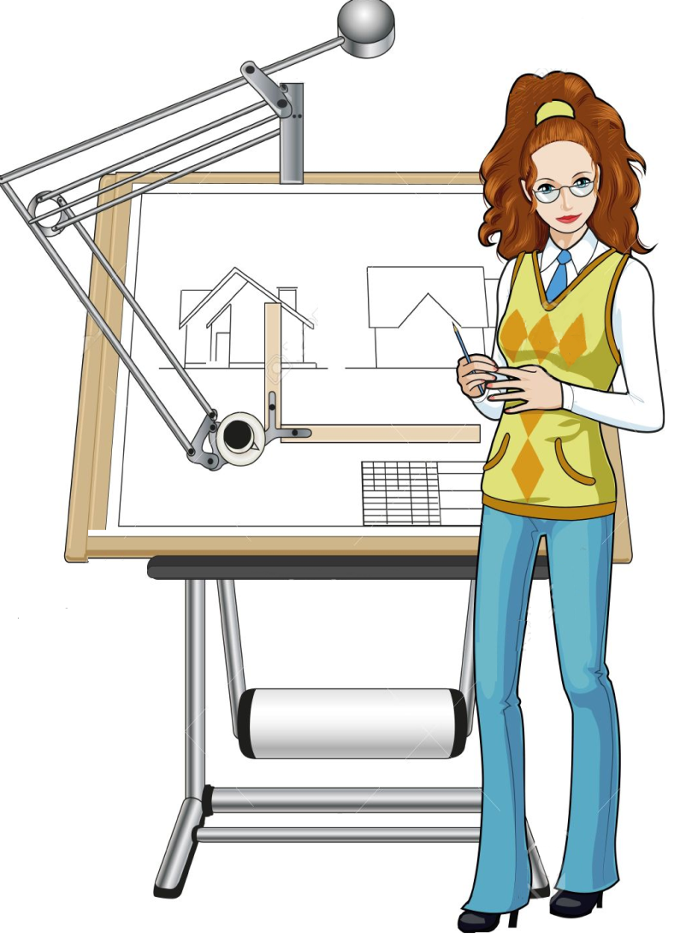
16. She designs houses for people.
Who is she?
What does she do?
(What’s her occupation?)

Slide 51
16. She designs houses for people.
She is an architect.

Slide 52
17. He introduces programs and people in a show.
Who is he?
What does he do?
(What’s his job?)

Slide 53
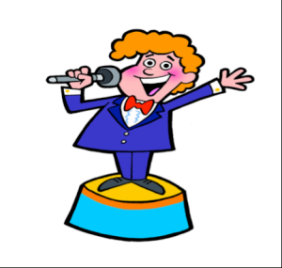
17. He introduces programs and people in a show.
Who is he?
What does he do?
What’s his job?)

Slide 54
17. He introduces programs and people in a show.
He is an MC.

Slide 55
18. She plays roles in movies/ films.
Who is she?
What does she do?
(What’s her job?)

Slide 56
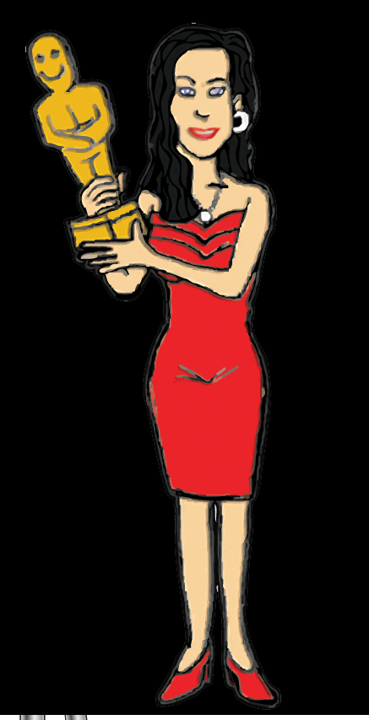
18. She plays roles in movies/ films.
Who is she?
What does she do?
(What’s her job?)

Slide 57
18. She plays roles in movies/ films.
She is an actress.

Slide 58
19. He directs films.
Who is he?
What does he do?
(What’s his job?)

Slide 59
19. He directs films.
Who is he?
What does he do?
(What’s his job?)

Slide 60
19. He directs films.
He is a film director.

Slide 61
20. She cleans her house, cooks food, washes clothes for her
family.
Who is she?
What does she do?
(What’s her job?)

Slide 62
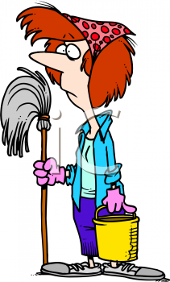
20. She cleans her house, cooks food, washes clothes for her family.
Who is she?
What does she do?
(What’s her job?)

Slide 63
20. She cleans her house, cooks food, washes clothes for her family.
She is a housewife.

Slide 64
21. She serves food and drink in a restaurant.
Who is she?
What does she do?
(What’s her job?)

Slide 65
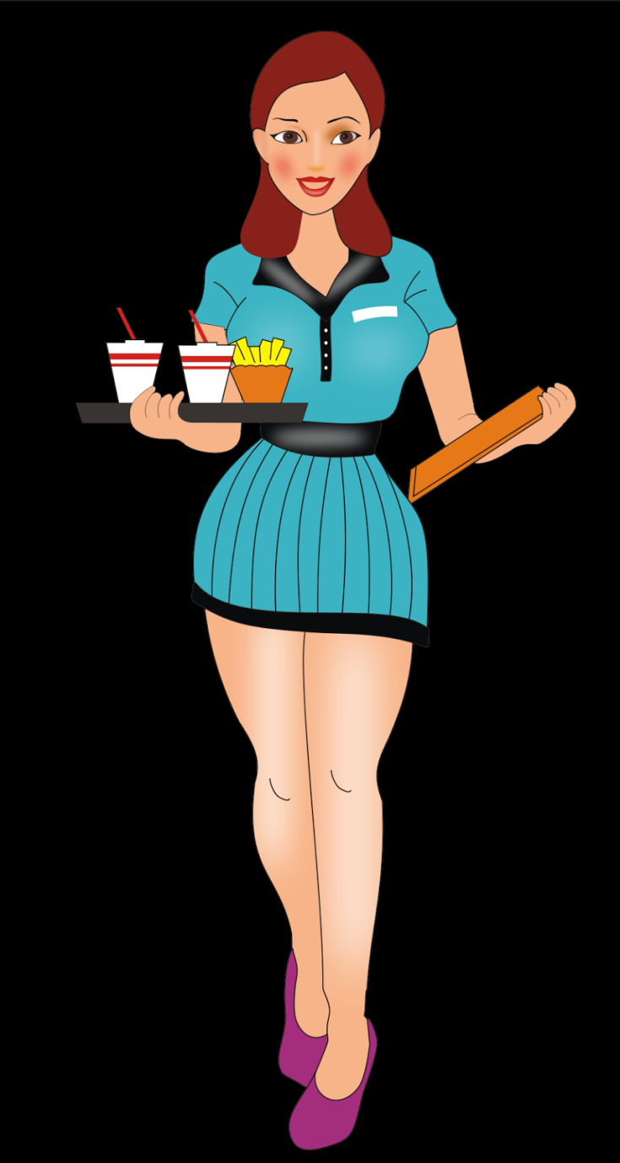
21. She serves food and drink in a restaurant.
Who is she?
What does she do?
What’s her job?)

Slide 66
21. She serves food and drink in a restaurant.
She is a waitress /
a caterer.

Slide 67
22. He makes wooden tables and chairs.
Who is he?
What does he do?
(What’s his job?)

Slide 68
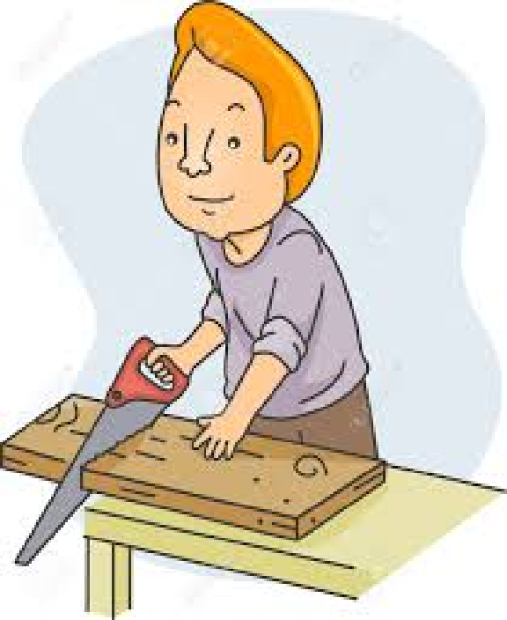
22. He makes wooden tables and chairs.
Who is he?
What does he do?
(What’s his job?)

Slide 69
22. He makes wooden tables and chairs.
He is a carpenter.

Slide 70
23. He goes and works on a sailing ship.
Who is he?
What does he do?
(What’s his job?)

Slide 71
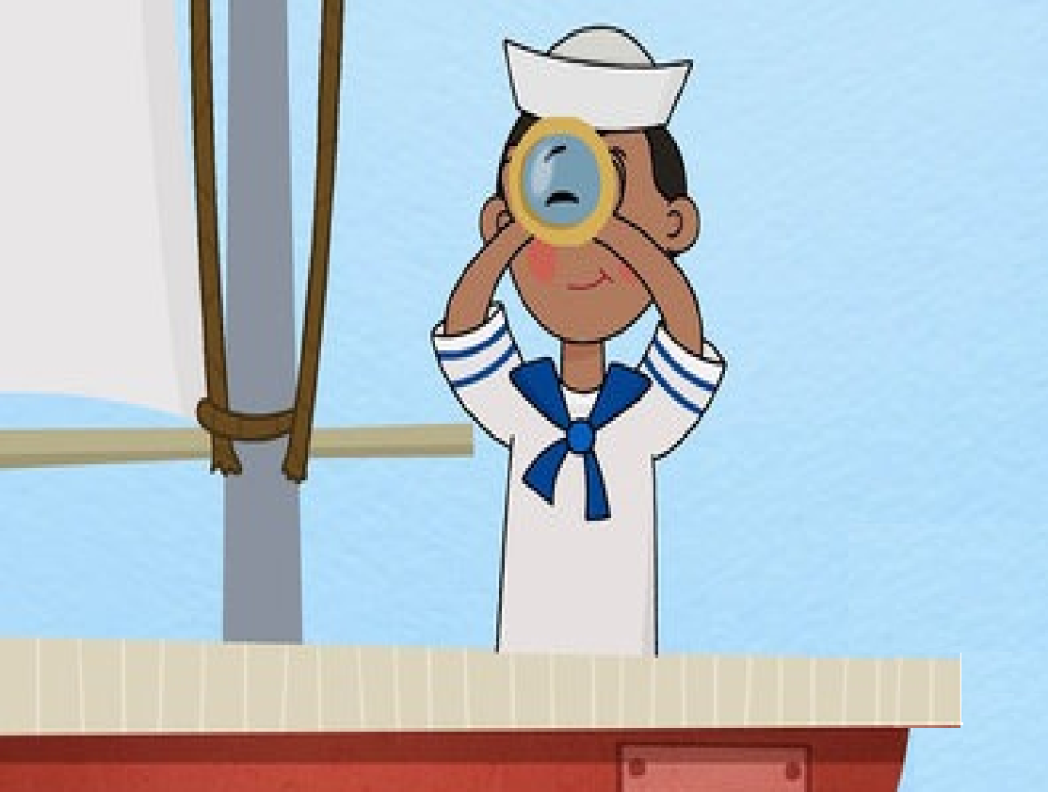
23. He goes and works on a sailing ship.
Who is he?
What does he do?
(What’s his job?)

Slide 72
23. He goes and works on a sailing ship.
He is a sailor.

Slide 73
24. In a hospital, he examines patients and gives prescription.
Who is he?
What does he do?
(What’s his job?)

Slide 74
24. In a hospital, he examines patients and gives prescription.
Who is he?
What does he do?
(What’s his job?)

Slide 75
24. In a hospital he examines patients and gives prescription.
He is a doctor.

Slide 76
25. She sells medicine in a drugstore.
Who is she?
What does she do?
(What’s her job?)

Slide 77
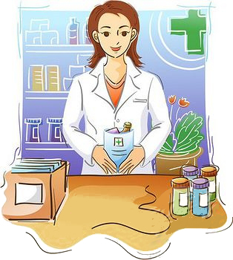
25. She sells medicine in a drugstore.
Who is she?
What does she do?
(What’s her job?)

Slide 78
25. She sells medicine in a drugstore.
She is a pharmacist / a chemist.

Slide 79
26. He studies law and helps people in a court.
Who is he?
What does he do?
(What’s his job?)

Slide 80
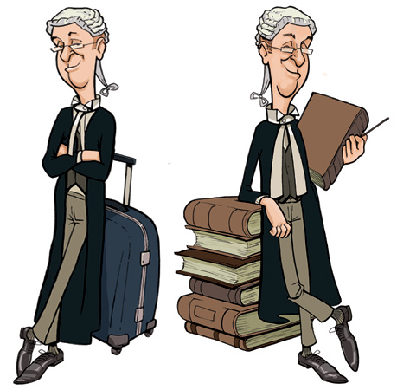
26. He studies law and helps people in a court.
Who is he?
What does he do?
(What’s his job?)

Slide 81
26. He studies law and helps people in a court.
He is a lawyer.

Slide 82
27. He makes final decisions in a court case.
Who is he?
What does he do?
(What’s his job?)

Slide 83
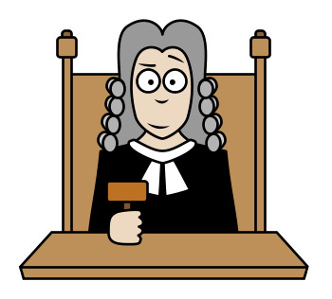
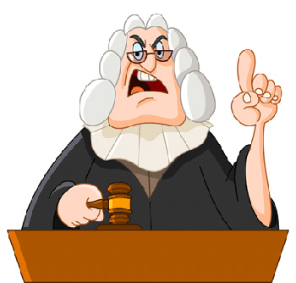
27. He makes final decisions in a court case.
Who is he?
What does he do?
(What’s his job?)

Slide 84
27. He makes final decisions in a court case.
He is a judge.

Slide 85
28. He studies Maths.
Who is he?
What does he do?
(What’s his occupation?)

Slide 86
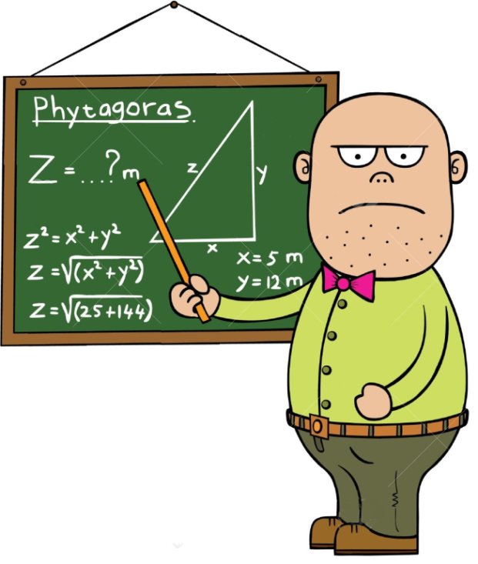
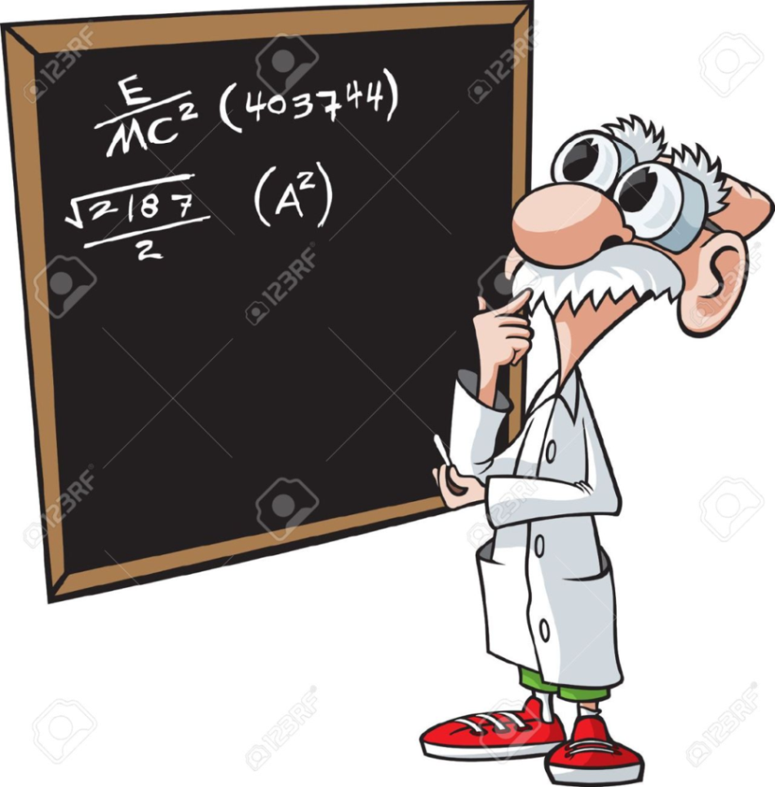
28. He studies Maths.
Who is he?
What does he do?
(What’s his occupation?)

Slide 87
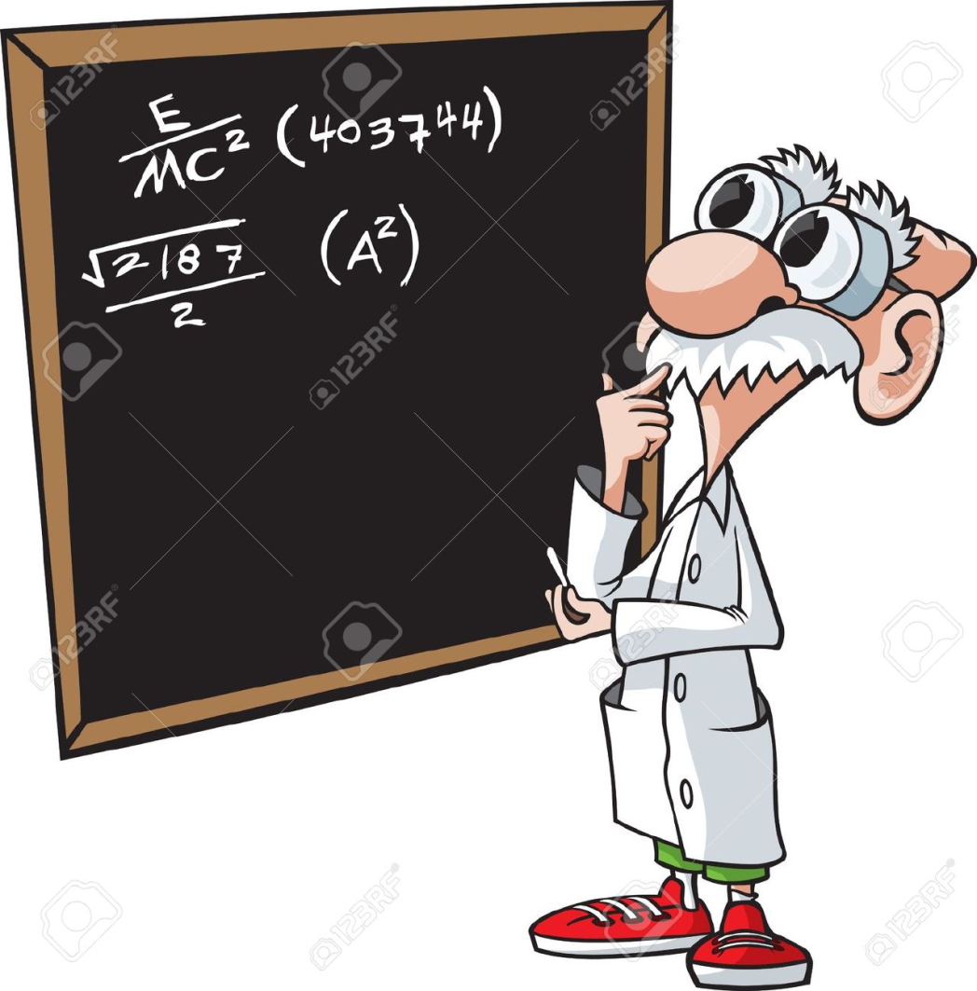
28. He studies Maths.
He is a mathematician.

Slide 88
29. She takes care of dogs and cats when they are ill.
Who is she?
What does she do?
(What’s her job?)

Slide 89
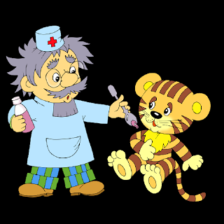
29. (S)he takes care of dogs and cats when they are ill.
Who is (s)he?
What does (s)he do?
(What’s her/his job?)

Slide 90
29. (S)he takes care of dogs and cats when they are ill.
(S)he is a vet.

Slide 91
She buys and sells
flowers.
Who is she?
What does she do?
(What’s her job?)

Slide 92
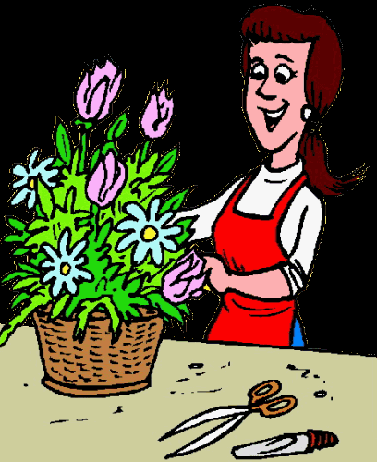
She buys and sells
flowers.
Who is she?
What does she do?
(What’s her job?)

Slide 93
She buys and sells
flowers.
She is a florist.

Slide 94
31. He checks and fixes teeth.
Who is he?
What does he do?
(What’s his job?)

Slide 95
31. He checks and fixes teeth.
Who is he?
What does he do?
(What’s his job?)

Slide 96
31. He checks and fixes teeth.
He is a dentist.

Slide 97
32. He is very good at numbers, salary and profit calculation.
Who is he?
What does he do?
(What’s his occupation?)

Slide 98
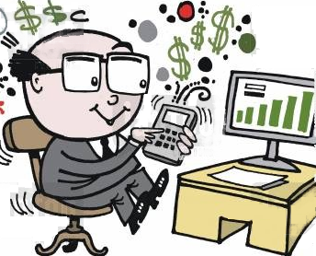
32. He is very good at numbers, salary and profit calculation.
Who is he?
What does he do?
(What’s his occupation?)

Slide 99
32. He is very good at numbers, salary and profit calculation.
He is an accountant.

Slide 100
33. He sells cars in a showroom.
Who is he?
What does he do?
(What’s his job?)

Slide 101
33. He sells cars in a showroom.
Who is he? What does he do?
(What’s his job?)

Slide 102
33. He sells cars in a showroom.
He is a car salesman.

Slide 103
34. He dances the ballet.
Who is he?
What does he do?
(What’s his job?)

Slide 104
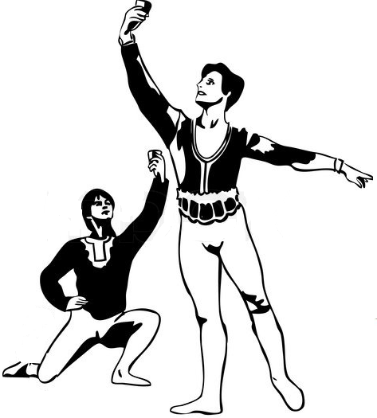
34. He dances the ballet.
Who is he?
What does he do?
(What’s his job?)

Slide 105
34. He dances the ballet.
He is a ballet dancer.

Slide 106
35. He performs or does tricks in a show.
Who is he?
What does he do?

Slide 107
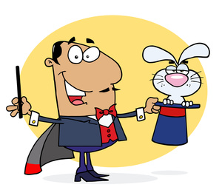
35. He performs or does tricks in a show.
Who is he?
What does he do?

Slide 108
35. He performs or does tricks in a show.
He is a magician.

Slide 109
36. She flies around on her broomstick.
Who is she?
What does she do?

Slide 110
36. She flies around on her broomstick.
Who is she?
What does she do?

Slide 111
36. She flies around on her broomstick.
She is a witch.

Slide 112
37. He takes photographs.
Who is he?
What does he do?
(What’s his job?)

Slide 113
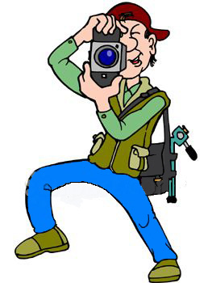
37. He takes photographs.
Who is he?
What does he do?
(What’s his job?)

Slide 114
37. He takes photographs.
He is a photographer.

Slide 115
38. He catches thieves.
Who is he?
What does he do?
(What’s his job?)

Slide 116
38. He catches thieves.
Who is he?
What does he do?
What’s his job?)

Slide 117
38. He catches thieves.
He is a policeman.

Slide 118
39. He makes bread.
Who is he?
What does he do?
(What’s his job?)

Slide 119
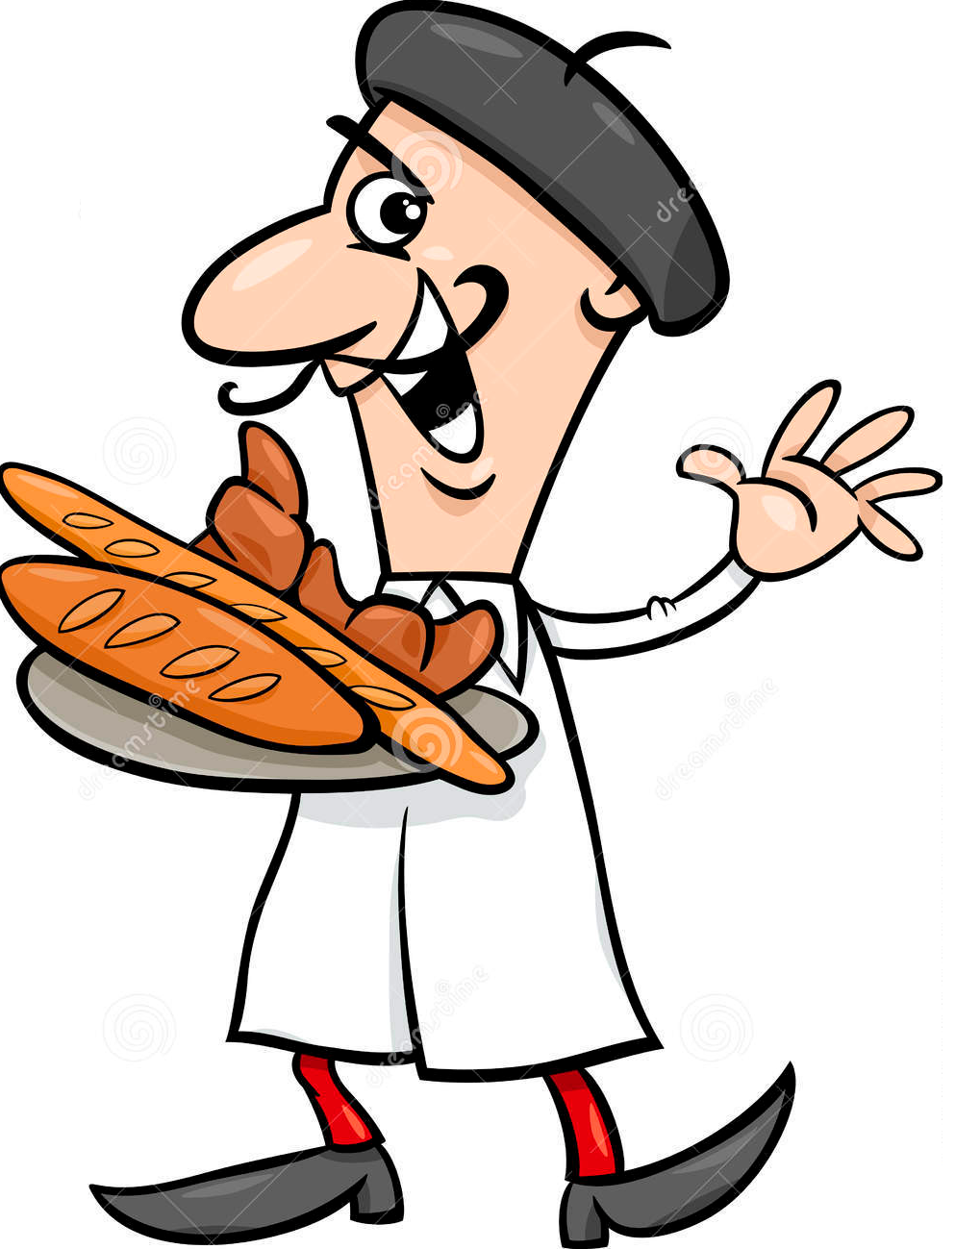
39. He makes bread.
Who is he?
What does he do?
(What’s his job?)

Slide 120
39. He makes bread.
He is a baker.

Slide 121
40. He steals people’s things.
Who is he?
What does he do?

Slide 122
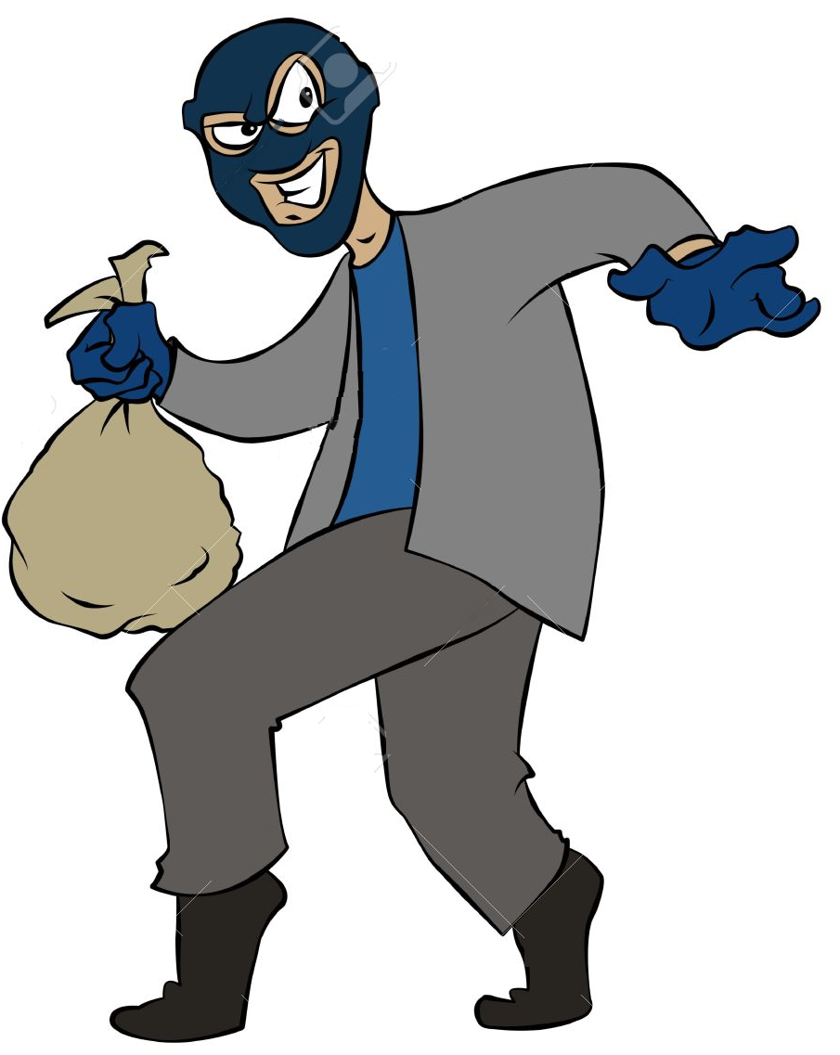
40. He steals people’s things.
Who is he?
What does he do?

Slide 123
40. He steals people’s things.
He is a thief.

Slide 124
2/- PRACTICE IN PAIRS: DESCRIBE , ASK, and ANSWER ABOUT JOBS/ OCCUPATIONS
Example:
Student A: He plays the guitar in a music band.
Who is he? or: What does he do?
Student B: He is a singer.
Student A: Sorry, that’s incorrect.
Student B: He is a guitarist.
Student A: Ok, that’s right.

Slide 125
3/- PRACTICE IN PAIRS
(Male)
Student A: He is a photographer.
What does he do?
Student B: He takes photographs.
(Female)
Student A: She is a dentist.
What does she do?
Student B: She checks and fixes teeth.

Slide 126
4/- GROUP DISCUSSION:
a- Which jobs are dangerous? Why?
b- What job are you interested in? Why?
c- What job aren’t you interested in? Why not?
d- Which job requires a lot of training?
e- Which job requires a lot of travelling?
f- What jobs are well-paid/ badly-paid?
g- What jobs show economic trends in Vietnam now?
h- What jobs are very strange to Vietnamese people?
i- What job does your close friend want to do?

Slide 127
That’s all !
THANK YOU !

